Slide 1

Medical Data Analysis
Data-Driven Insights for Hospital Management
BY-VIJAY CHINCHKAR(September 2025)
MY GITHUB REPOSITORY: https://github.com/Vijay7972

Slide 2
PURPOSE OF ANALYSIS
This analysis aims to improve patient care and optimize hospital resources. By examining treatment patterns and staff efficiency, we can make smarter decisions to enhance services and outcomes for everyone..

Slide 3
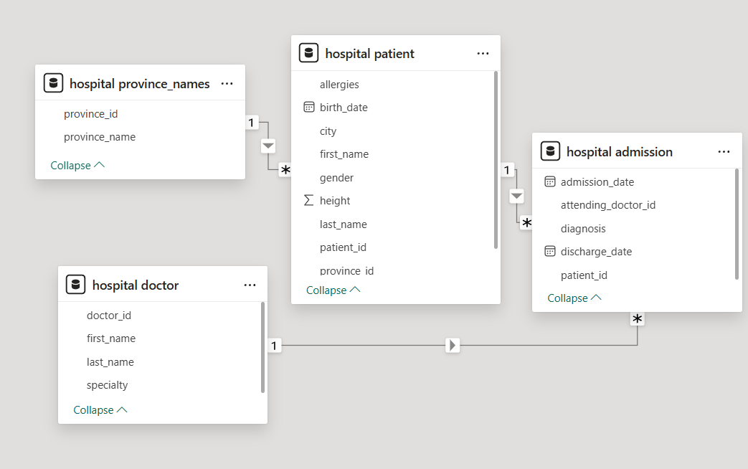
SCHEMA & DATA

Slide 4
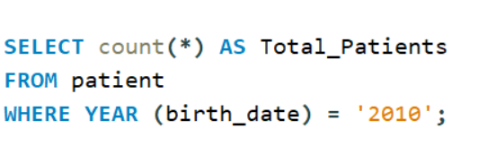

BASIC QUERIES
1. Show how many patients have a birth_date with 2010 as the birth year.

Slide 5
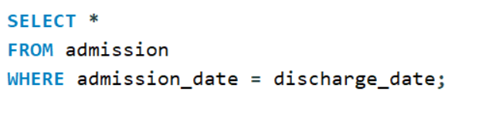
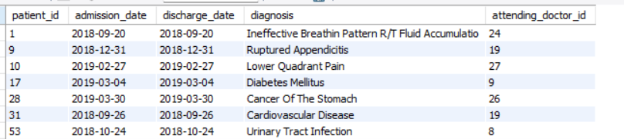
BASIC QUERIES
2. Show all the columns from admissions where the patient was admitted and discharged on the same day.

Slide 6
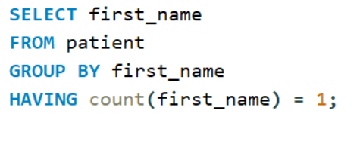
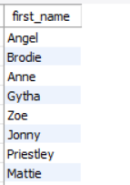
BASIC QUERIES
3. Show unique first names from the patients table which only occurs once in the list.

Slide 7
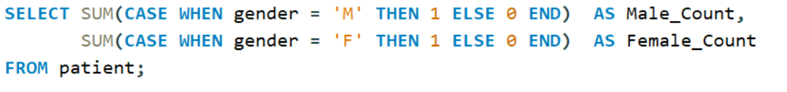

BASIC QUERIES
4. Show the total amount of male patients and the total amount of female patients in the patients table. Display the two results in the same row.

Slide 8
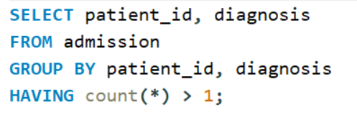
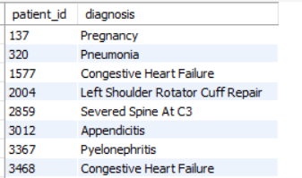
INTERMIDIATE QUERIES
5. Show patient_id, diagnosis from admissions. Find patients admitted multiple times for the same diagnosis.

Slide 9
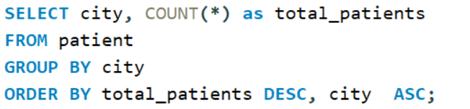
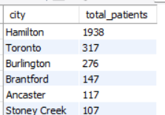
INTERMIDIATE QUERIES
6. Show the city and the total number of patients in the city. Order from most to least patients and then by city name ascending.

Slide 10
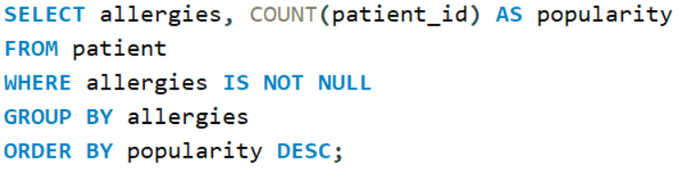
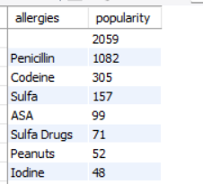
INTERMIDIATE QUERIES
7. Show all allergies ordered by popularity. Remove NULL values from query.

Slide 11
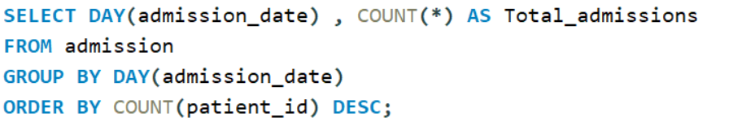
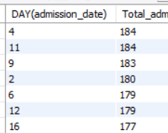
INTERMIDIATE QUERIES
8. Show all of the days of the month (1-31) and how many admission_dates occurred on that day. Sort by the day with most admissions to least admissions.

Slide 12
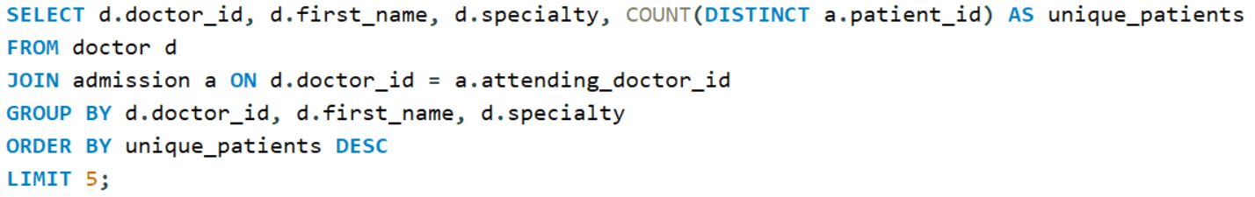
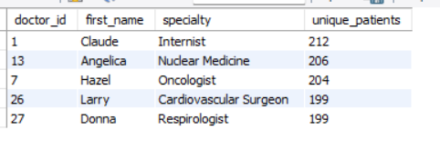
ADVANCED QUERIES
9.Top Doctors by Patient Reach.

Slide 13
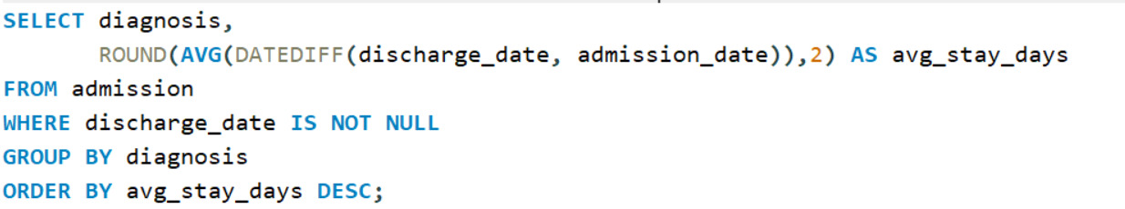
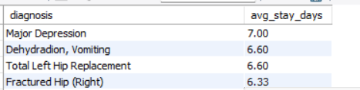
ADVANCED QUERIES
10. Average Length of Stay (LOS) per Diagnosis

Slide 14
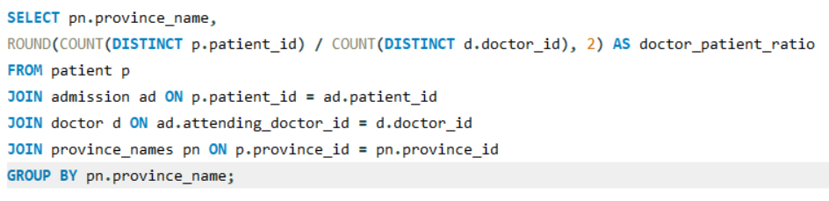
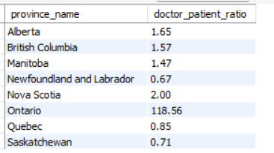
ADVANCED QUERIES
11. Patient-to-Doctor Ratio by Province.

Slide 15
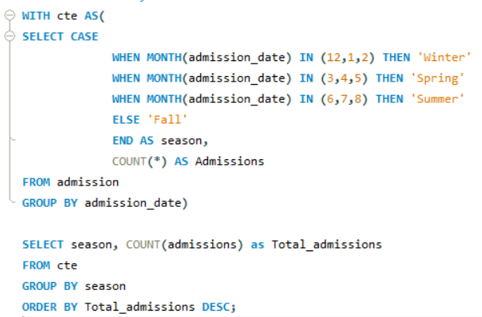
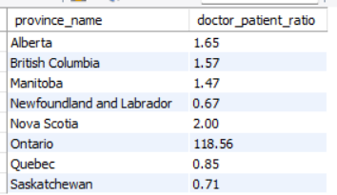
ADVANCED QUERIES
12.Admissions by Season.

Slide 16
INSIGHTS
The hospital had 55 patients born in 2010, with a nearly balanced male-to-female ratio.
Admissions stayed steady across seasons: Summer 92, Spring 92, Fall 91, Winter 90.
Dr. Claude (Internist) treated 212 unique patients, followed by Dr. Angelica (Nuclear Medicine) with 206.
Some diagnoses led to repeat admissions, and the average stay length varied by condition.
Hamilton had the highest patient volume (1,938), while Toronto had 317, showing uneven city demand.

Slide 17
SUGGESTION To Increase Patients
Add more support for children’s care and vaccinations since many young patients visit.
Keep staff levels steady all year, because admissions don’t change much by season.
Share the workload among doctors, especially in busy specialties.
Give patients follow-ups and guidance to avoid repeat hospital visits.
Put more staff and resources in Hamilton, as it has the most patients

Slide 18
Thank
You!

